Slide 1


Slide 2
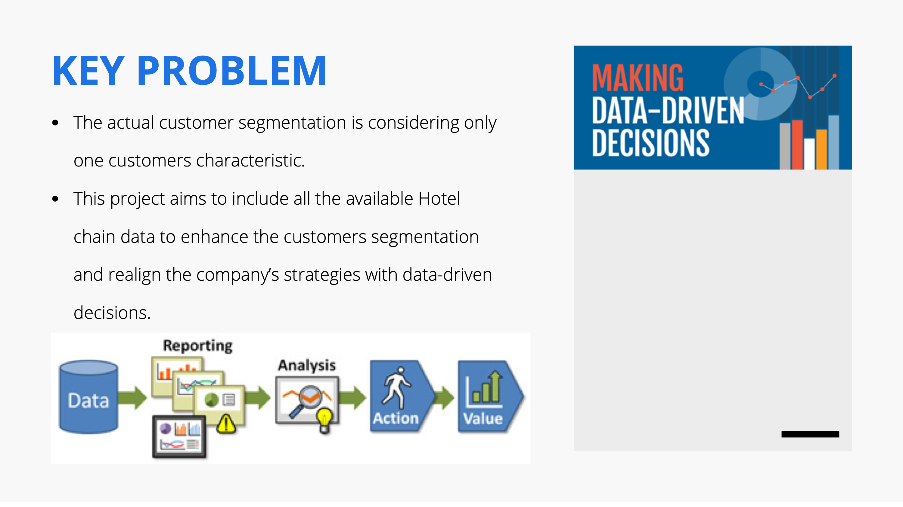
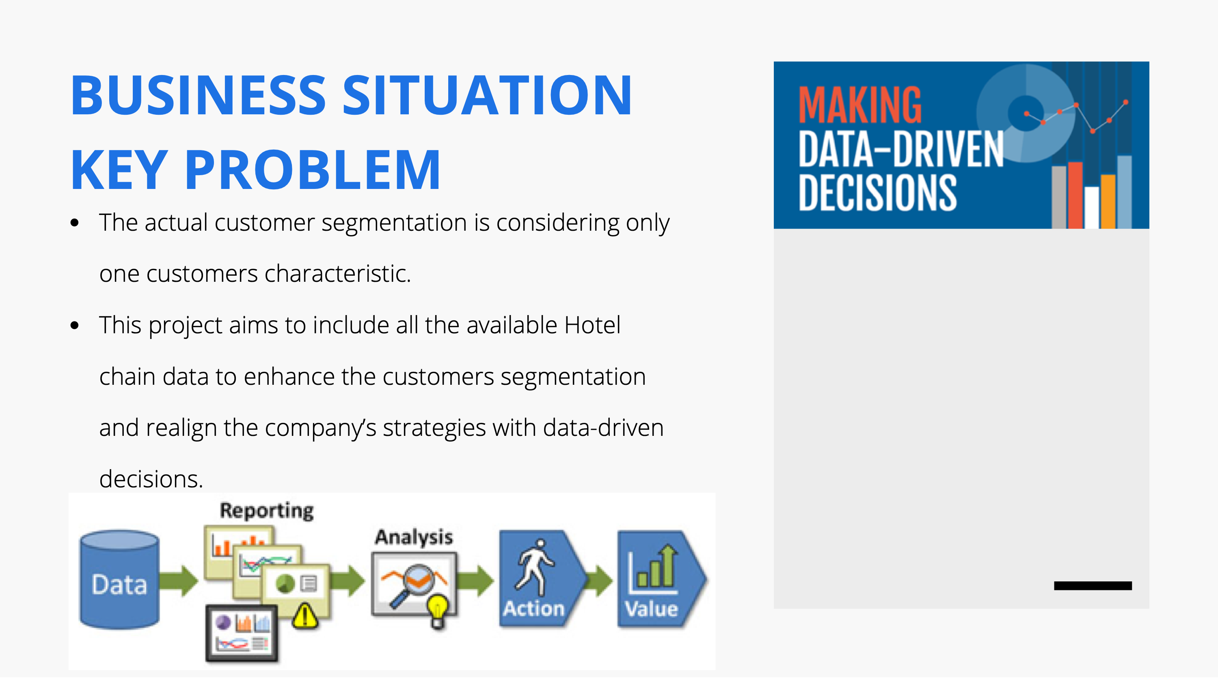


Slide 3
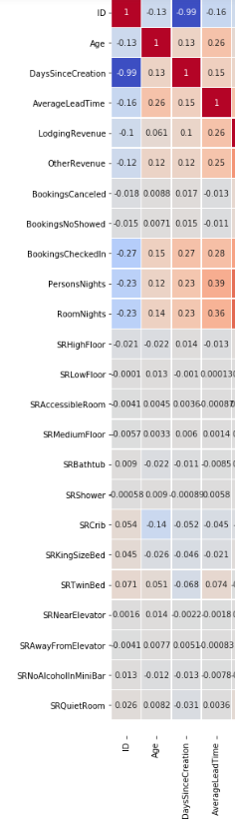
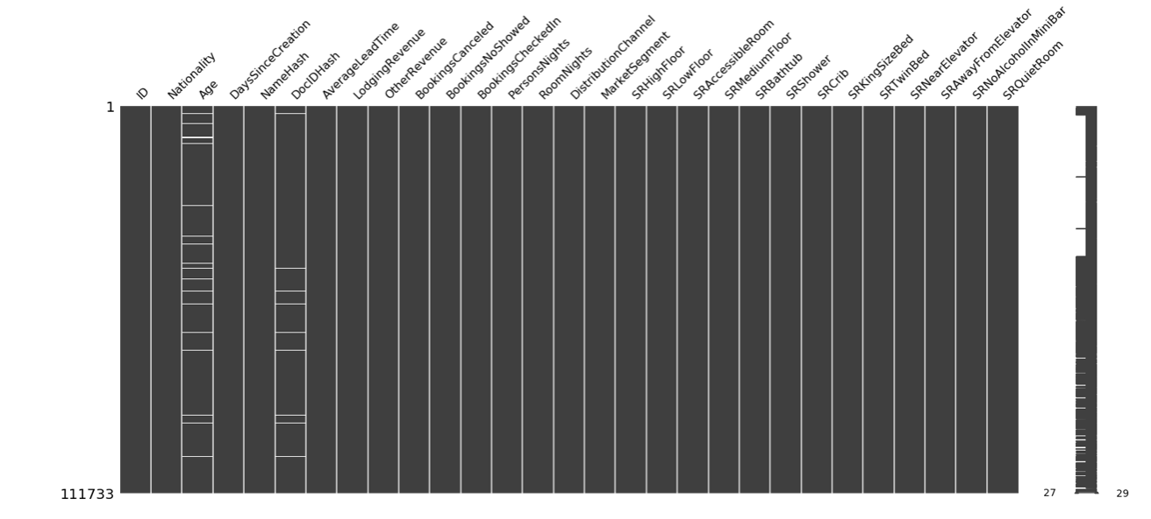
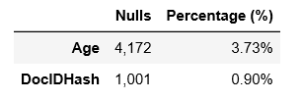

Slide 6
No duplicates found in the dataset
Check if: unique ID → unique individual
Use NameHash ∩ DocIDHash

Slide 7
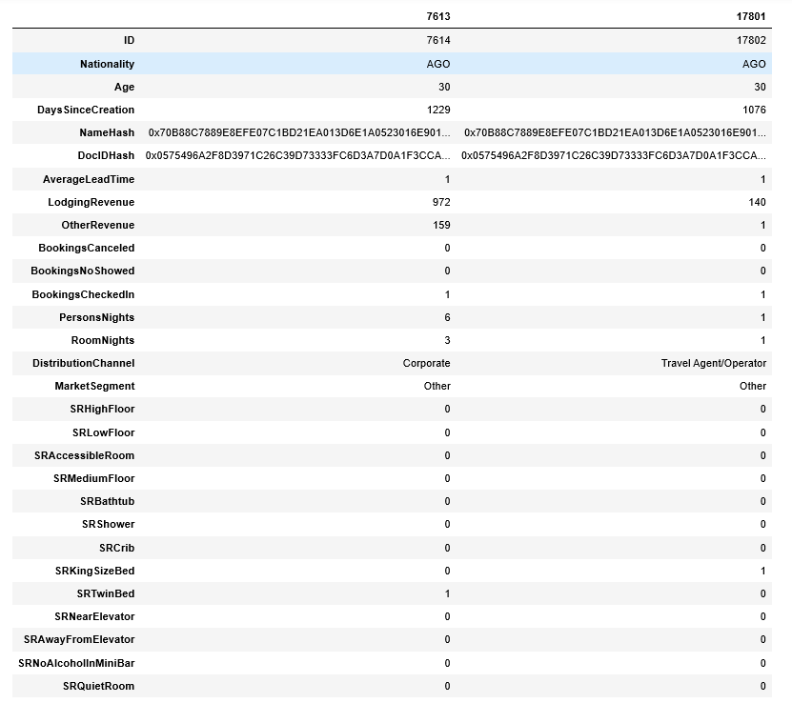
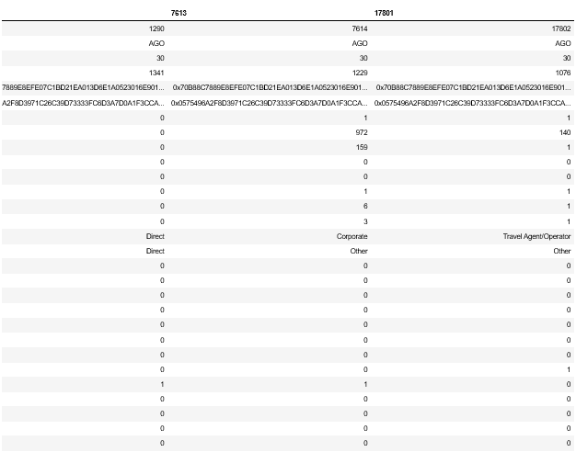
Minimum
Maximum
Mean
Mode
Sum

Slide 8
Minimum
Maximum
Mean
Mode
Sum

Slide 9
Minimum
Maximum
Mean
Mode
Sum

Slide 10
Minimum
Maximum
Mean
Mode
Sum

Slide 11
Minimum
Maximum
Mean
Mode
Sum

Slide 12
Minimum
Maximum
Mean
Mode
Sum

Slide 13
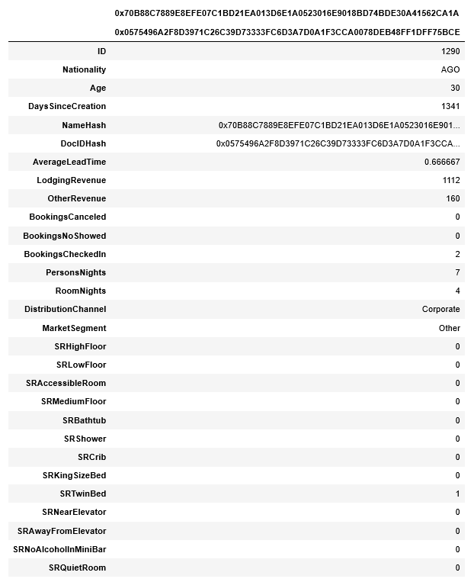
107561 records
- 2948
104613 records

Slide 14
DROPPED
Age
→ Age_bin
25
45
65
85
18
100

Slide 15
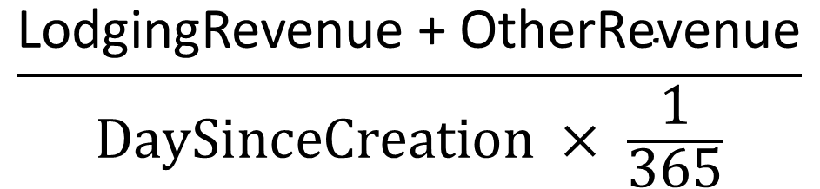
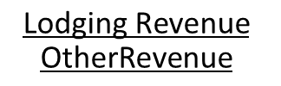
DROPPED
$$\text{Lodging} \text{Revenue}$$
$$\text{OtherRevenue}$$
→ Average Revenue per Year
$$\frac{\text{LodgingRevenue} \text{+ }\text{OtherRevenue}}{DaySinceCreation × \frac{1}{365}}$$
Average Revenue per Year =

Slide 16
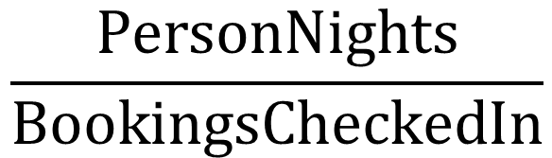
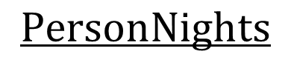
DROPPED
$$PersonNights$$
→ PersonNights per Booking
$$\frac{PersonNights}{BookingsCheckedIn}$$
PersonNights per Booking =

Slide 17
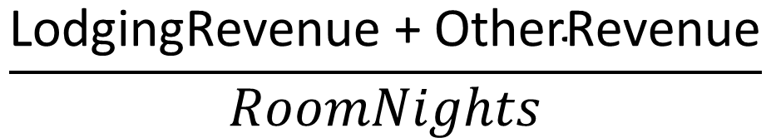
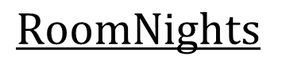
DROPPED
$$RoomNights$$
→ Revenue per Room per Night
$$\frac{\text{LodgingRevenue}\text{ + }\text{OtherRevenue}}{RoomNights}$$
Revenue per Room per Night =

Slide 18
DROPPED
BookingsCheckedIn
BookingsCanceled
BookingsNoShowed
BookingsCheckedInprt
BookingsCanceledprt
BookingsNoShowedprt
→
Bookings_X_prt =
$$\frac{Bookings_X}{\text{BookingsCheckedIn} + \text{BookingsCanceled}\text{ + }\text{BookingsNoShowed} }$$

Slide 19
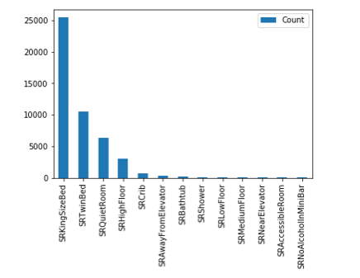
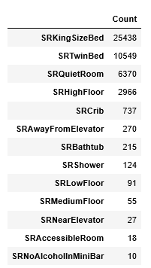
DROPPED

Slide 20
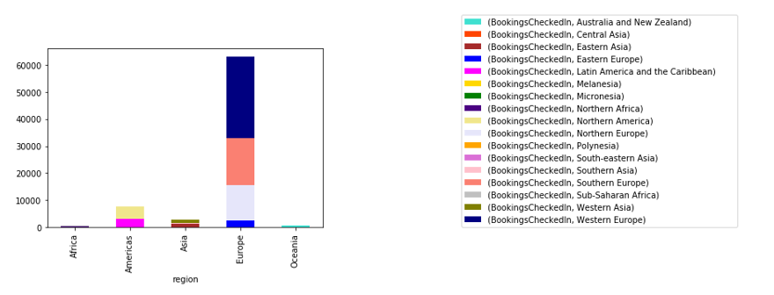
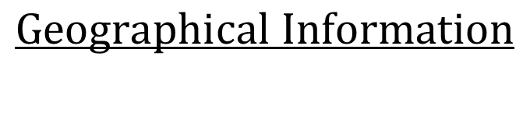
New variables:
Region
Sub-Region
NOT CONSIDERED
$$Geographical Information$$

Slide 21
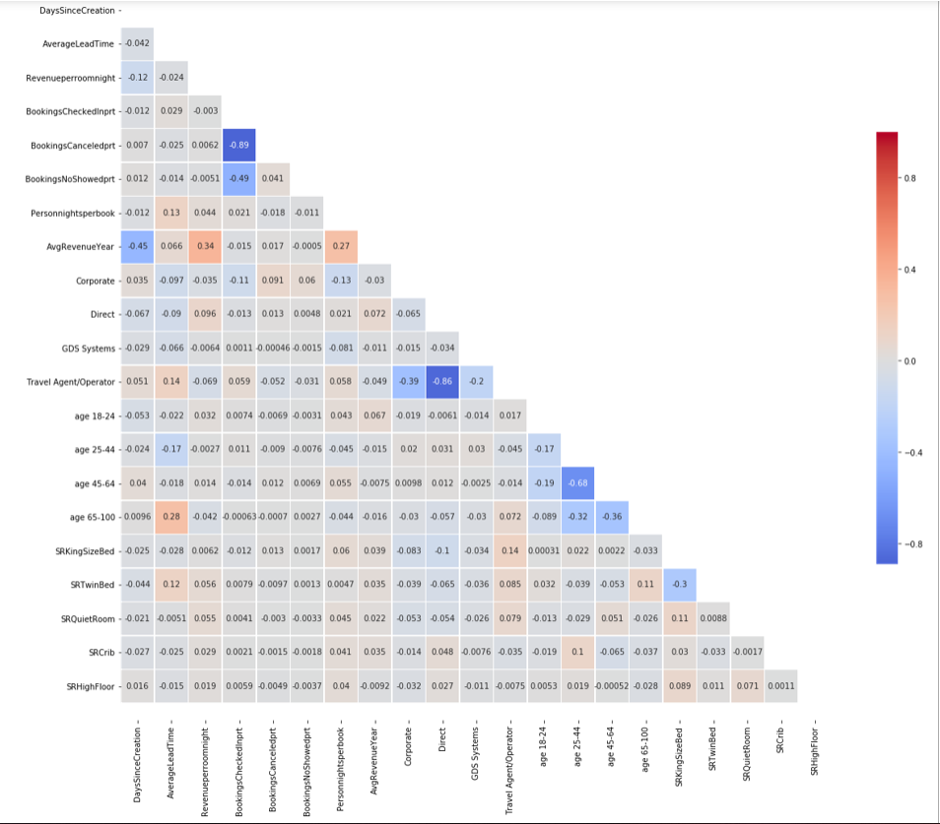
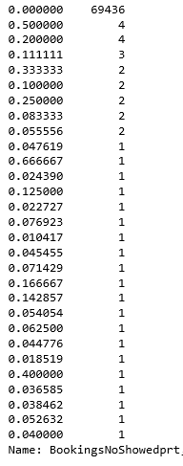
Corr ( BookingsCheckedInprt , BookingsNoShowedprt)
=
-0.49
DROPPED
BookingsNoShowedprt

Slide 22

Corr (BookingsCheckedInprt, BookingsCanceledprt)
=
-0.89
DROPPED
BookingsCanceledprt
$$\text{BookingsCanceled}\text{= }$$
$$\text{100 − (}\text{BookingsCheckedIn} +\text{BookingsNoShowed}\text{)}$$
0

Slide 23
Corr (PersonNightsperbook, Revenueperroomnight)
=
-0.56
DROPPED
PersonNightsperbook

Slide 24
Corr ( Travel Agent/Operator, Direct )
=
-0.86
Corr ( age 45-64, age 25-44 )
=
-0.68

Slide 26
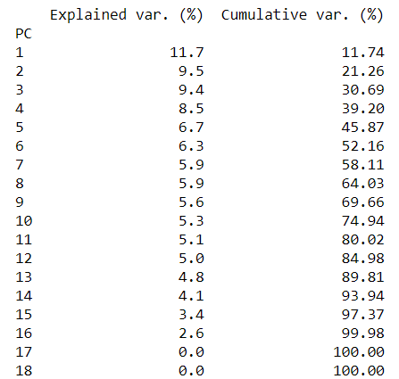
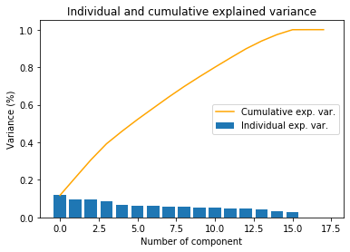
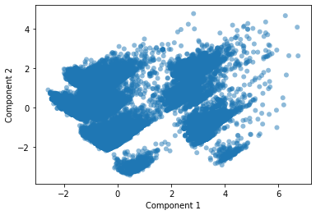

Slide 27
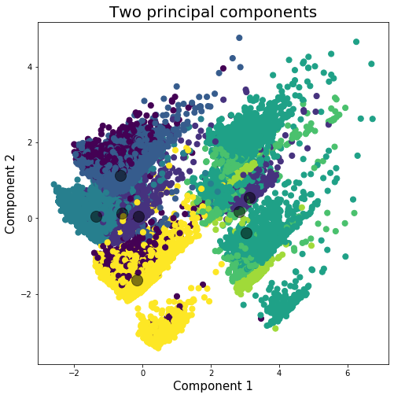
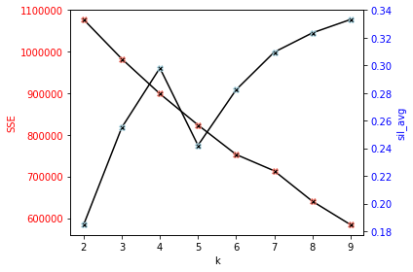

Slide 28


Slide 29


Slide 30


Slide 31


Slide 32


Slide 33


Slide 34


Slide 35


Slide 36


Slide 37


Slide 38


Slide 39


Slide 40
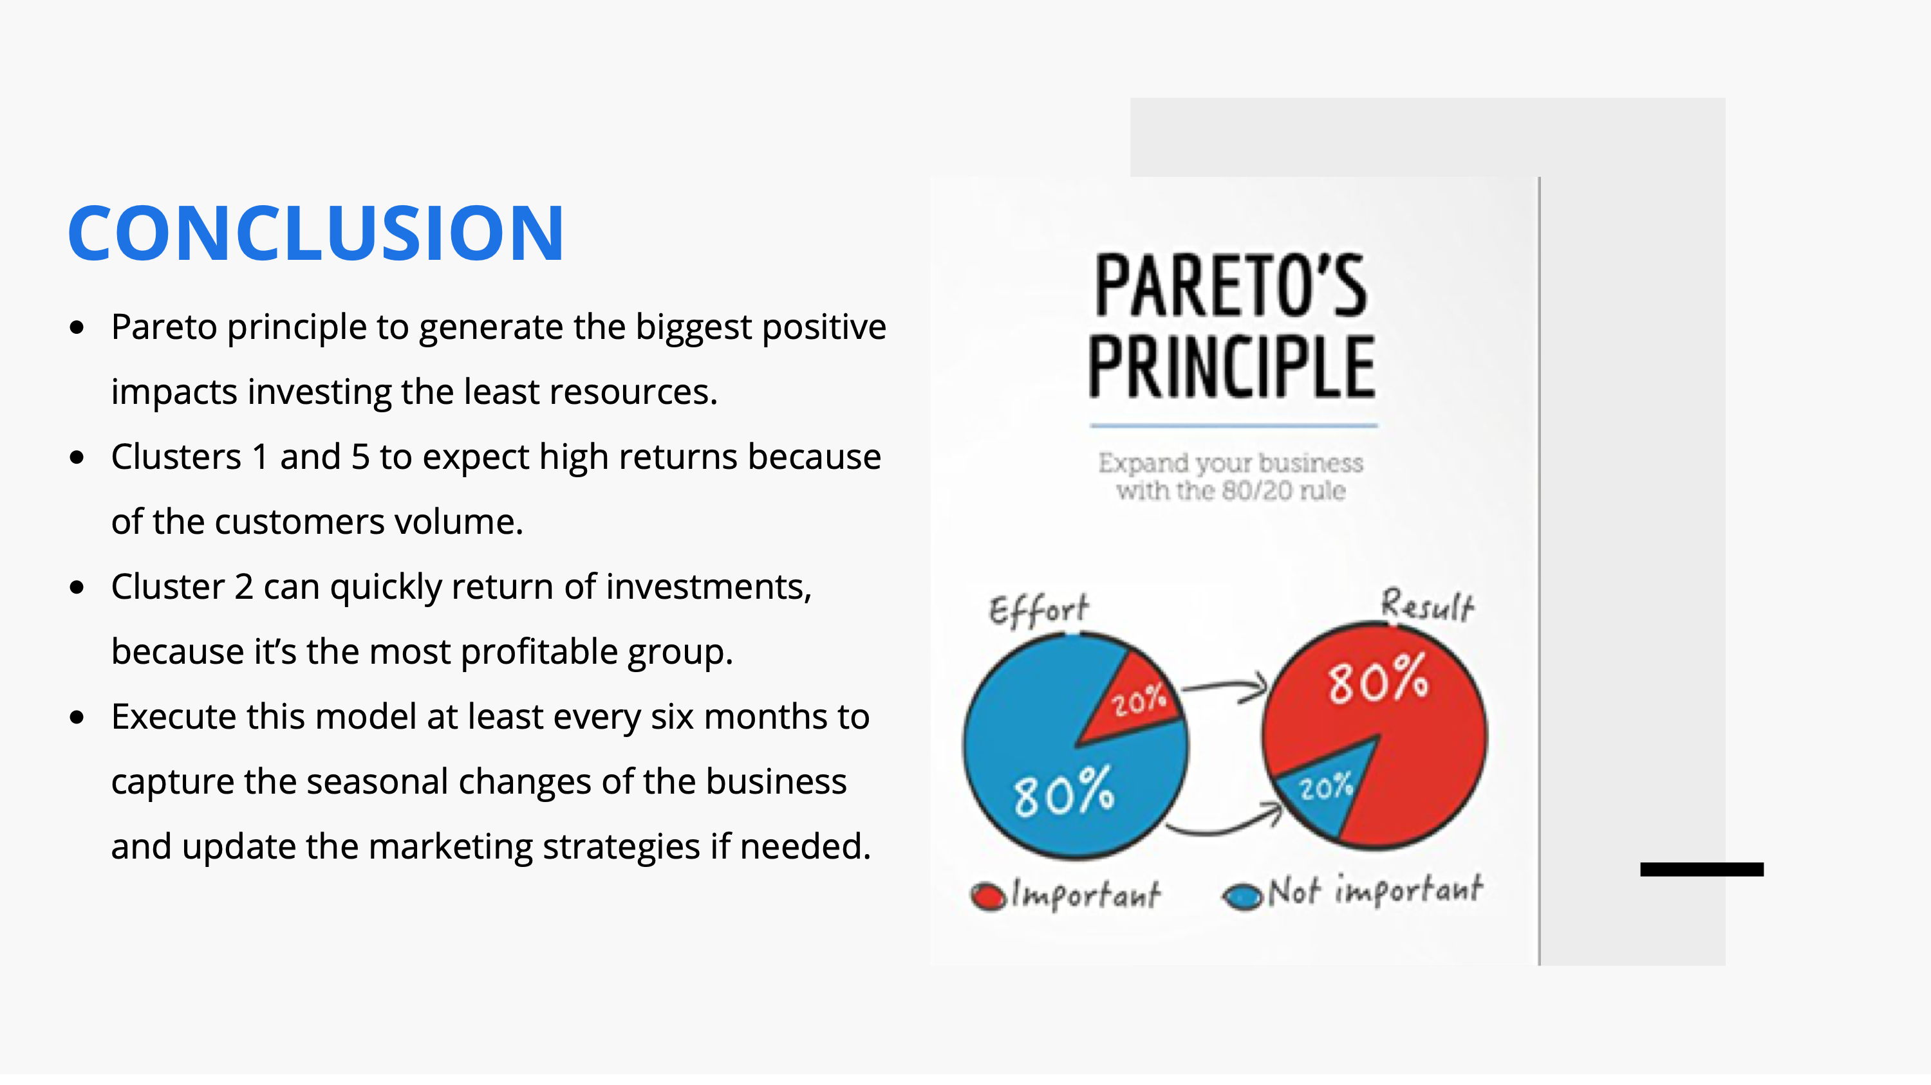

Slide 41


